Slide 1
Application Security for SAP
Using the Fortify Product Portfolio
October 2025

Slide 2

Agenda
SAP Evolution (ERP+)
SAP Customization
SAP Development Stack
OpenText AppSec solutions for SAP
Competition

Slide 3
SAP Evolution (ERP and beyond)
SAP R/3
SAP S4/HANA
SAP BTP
~2004
SAP ECC
Client-Server 3 tier model
Evolution of R/3
~2015
~1992
Supported till 2040
~2012 (renamed BTP since 2022)
PAAS – collection of services in the cloud
Integrated with ECC and S4/HANA – our-of-core customizations
Environments: Cloud Foundry, ABAP, Kyma
On-prem or Cloud
Fiori Launchpad
SAP GUI
EOL 2027
On-prem
On-prem
EOL 2027
Extended support to 2030
Still Client-Server based
Language support: ABAP, Java, Node.JS, Python, Go etc
Language support: ABAP
Language support: ABAP (internal), Java (external)
Language support: ABAP, Java, Node.JS (Fiori)
Notes:
ECC = ERP Central Component
BTP = Business Technology Platform

Slide 4
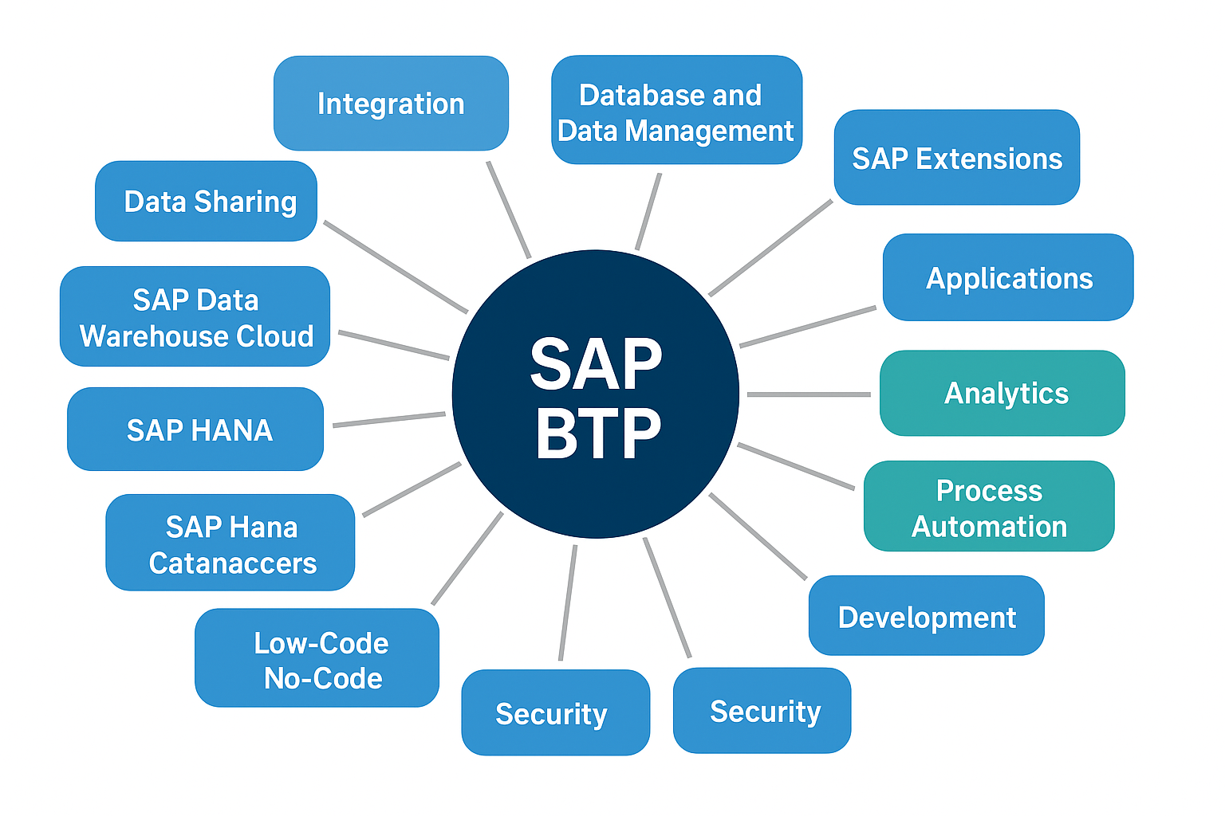
SAP BTP (Business Technology Platform)

Slide 5
SAP Migrations from ECC to S4/HANA
By end of Q4 2024, ~39% of ECC customers had licensed S/4HANA. [The Register]
Only ~28% (or slightly more) had fully migrated / were live as of early 2025. [Datalink Dynamics]
Many are still in transition, planning, or evaluating. [Datalink Dynamics]
It is project that ~57% will have completed migration end of 2027, ~80% by end of 2030
~17% of SAP ERP customers run in the cloud (30-33% for S/4HANA only)
~55% of SAP customers use BTP (73% of which in context of S/4HANA) [ASUG]

Slide 6
SAP Typical Customizations

Slide 7
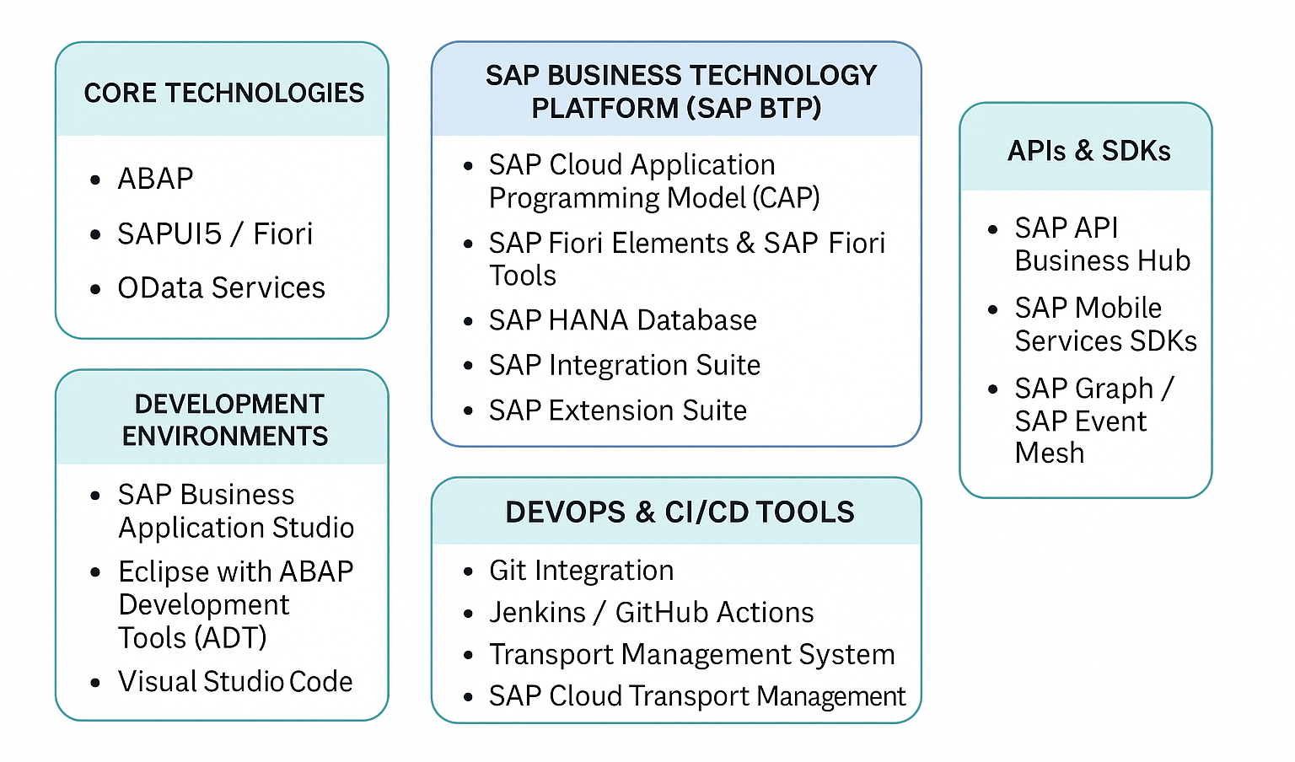
SAP Development Stack

Slide 8
ABAP Evolution
ABAP (Advanced Business Application Programming), SAP’s proprietary programming language, has undergone significant evolution since its inception in the 1980s.
Procedural Roots (1980s-1990s)
Initially designed for developing reports and interfaces in SAP R/2 and later R/3
Purely procedural, similar to COBOL
No object-oriented features, limited modularity
Object Oriented (2000s)
ABAP Objects introduced with SAP R/3 4.6c
Enabled encapsulation, inheritance and polymorphism
Class-based exception handling (replaced older MESSAGE-based error handling)
Integration with Web (2010s)
ABAP in the Cloud (Late 2010s-2020s)
Web Dynpro ABAP: UI framework for building web-based applications
SAP NetWeaver: ABAP a core part of NetWeaver stack, supporting web services and RFCs
REST & OData: ABAP gained capabilities to expose services via Odata, enabling Fiori and mobile apps
ABAP for SAP S/4HANA: Optimized for HANA database with features like Core Data Services (CDS) AMDP and better performance
ABAP RESTful Application Programming Model (RAP)
Steampunk (ABAP Environment in SAP BTP)
Notes:
ABAP (Advanced Business Application Programming), SAP’s proprietary programming language, has undergone significant evolution since its inception in the 1980s. Here's a breakdown of how ABAP has developed over the years:
1. Early Days (1980s–1990s): Procedural Roots
Purpose: Initially designed for developing reports and interfaces in SAP R/2 and later SAP R/3.
Style: Purely procedural, similar to COBOL.
Limitations: No object-oriented features, limited modularity.
2. Rise of Object-Oriented ABAP (2000s)
ABAP Objects (ABAP OO) introduced with SAP R/3 4.6C.
Enabled encapsulation, inheritance, and polymorphism, aligning ABAP with modern programming paradigms.
Class-based exception handling replaced older MESSAGE-based error handling.
3. Integration with Web Technologies (2010s)
Web Dynpro ABAP: A UI framework for building web-based applications.
SAP NetWeaver: ABAP became a core part of the NetWeaver stack, supporting web services and RFCs.
REST & OData: ABAP gained capabilities to expose services via OData, enabling Fiori and mobile apps.
4. ABAP in the Cloud Era (Late 2010s–2020s)
ABAP for SAP S/4HANA: Optimized for HANA database with features like Core Data Services (CDS), AMDP (ABAP Managed Database Procedures), and better performance.
ABAP RESTful Application Programming Model (RAP):
Introduced to build cloud-ready, service-oriented applications.
Emphasizes metadata-driven development, reusability, and separation of concerns.
Steampunk (ABAP Environment in SAP BTP):
ABAP in the cloud, decoupled from SAP S/4HANA.
Encourages clean core and side-by-side extensions.
5. Modern ABAP Features
Syntax Enhancements: Inline declarations (DATA(...)), new loop constructs, and expressions.
Testability: Support for unit testing via ABAP Unit.
Security & APIs: Improved support for OAuth, JWT, and secure APIs.
Developer Experience: ABAP Development Tools (ADT) in Eclipse replaced SE80 for modern development.

Slide 9
SAP Custom Development Approaches
SAP Business Technology Platform (BTP): Cloud-based development with Java, Node.js, Python, ABAP
SAP ABAP Development: Traditional in-system development for custom logic
SAP Fiori/UI5: Modern web apps using HTML5, JavaScript, SAPUI5
In-App Extensions: Key user tools for quick customizations without coding
Side-by-Side Extensions: External apps on SAP BTP using APIs and events
Embedded Development: Direct enhancements within SAP S/4HANA using ABAP

Slide 10
ABAP Development
Development Environments:
• SAP GUI with ABAP Workbench (SE80)
• Eclipse with ABAP Development Tools (ADT)
Key Objects:
• Reports, Function Modules, Classes & Methods
• Data Dictionary (Tables, Views, Domains)
• SmartForms, Enhancements & User Exits
Development Process:
• Requirement Gathering → Technical Design → Coding → Testing → Transport
Types of Programs:
• Classical Reports, ALV Reports
• Dialog Programming, Web Dynpro ABAP
• OData Services for SAP Fiori

Slide 11
Fiori Apps Development
Development Environments:
• SAP Business Application Studio )part of BTP)
SAP Web IDE (deprecated)
Visual Studio Code
Key Objects:
• Annotations, Manifest.json, Component.js,
Models, Views (XML, JSON, HTML), Fragments, Controllers
FLP Configuration
Development Process:
• Requirement Gathering → Technical Design → Coding → Testing → Transport
Types of Programs:
• Web or Mobile
Transactional Apps, Analytical Apps, Dashboards, Overviews, Worklists

Slide 12
CI/CD Tools for SAP Development
SAP CI/CD Service: Native BTP service for building and deploying SAP apps
Project 'Piper': Open-source CI/CD framework with Jenkins pipelines
Jenkins: Widely used with ABAP CI plugin for ATC checks and transports
GitHub Actions / GitLab CI: Popular for CAP, UI5, and Node.js apps
abapGit: Enables version control and Git integration for ABAP code

Slide 13
SAP Application Security Practices
🔍 ABAP Code Scanning: Use ATC (ABAP Test Cockpit) and SCI (Code Inspector) to detect vulnerabilities.
🔐 Authorization Checks: Implement AUTHORITY-CHECK and manage roles via SU24 and PFCG.
🌐 Secure Connectivity: Use SAP Cloud Connector and HTTPS/TLS for secure data transmission.
👥 Identity & Access Management: Apply OAuth 2.0, SAML, and SAP IAS for user authentication.
🧾 Audit & Monitoring: Enable SAP Security Audit Log, Cloud ALM, and Solution Manager for compliance.

Slide 14
Example SAP Development Stages and Tools
Plan Jira, SAP Solution Manager
Code ADT (ABAP), Business Application Studio (UI5/CAP)
Scan ABAP Test Cockpit (ATC), SonarQube, Fortify
Build Jenkins, SAP CI/CD Service
Test ABAP Unit, JUnit, Mocha
Package abapGit, MTA Builder
Deploy gCTS, TMS, BTP CLI
Monitor SAP Cloud ALM, Solution Manager

Slide 15
Adoption Trends: ABAPGit and SAP CI/CD Tools
ABAPGit is widely adopted for version control of ABAP code in SAP on-premise and BTP environments.
Used by SAP partners and developers for code transport, auditing, and CI integration.
SAP CI/CD Service is gaining traction for managing pipelines in SAP BTP (Fiori, CAP, ABAP).
Project 'Piper' is SAP’s open-source Jenkins-based framework for CI/CD automation.
Jenkins is commonly used with ABAP CI plugin for ATC checks and transports.
GitHub Actions and GitLab CI are popular in hybrid SAP landscapes for CAP and UI5 apps.
SAP provides Docker images and templates for CI/CD integration via Project Piper.

Slide 16









OpenText Application Security (DevSecOps)
OpenText Application Security Platform
Governance
DevOps
IDE
ITSM
CICD
SAST
SCA
DAST/MAST
Posture Mgmt
Source Control
Supply Chain
Defect Mgmt
Open Source Select
Compliance
Cloud
Fortify Aviator
OSPO
Secure Development Training
Public Cloud
Private Cloud
Off Cloud
Premium Support and Services
Notes:
IDE = Integrated development environment
CICD = Continuous integration/continuous deployment
ITSM = IT service management (ServiceNow, etc)
OSPO = Open source policy office
DevOps inputs go into our platform and the governance “strategic actions” that come out, all underlined by our basic products of SCA, SAST, DAST etc.

Slide 17
Fortify ABAP – What’s New
Fortify Static Code Analyzer version 24.4 supports ABAP Platform 2023 / ABAP 7.58
The support includes S/4 HANA.
Version 24.4 also improves our support for the older ABAP 6 version
Minor limitation: data flows through “table types”, “REDUCE” operator not yet supported.
Notes:
https://www.microfocus.com/en-us/assets/cyberres/magic-quadrant-for-application-security-testing

Slide 18
Fortify ABAP – Latest Rule pack
Fortify Software Security Content Update 25.1 - Fortify Tips - OpenText Fortify
ABAP (Advanced Business Application Programming) is SAP’s primary programming language for developing robust business applications within the SAP ecosystem. It supports both procedural and object-oriented paradigms, integrates seamlessly with SAP’s data and application frameworks, and underpins a wide range of enterprise-level solutions. Improvements to category coverage span 11 existing categories and adds support for the following categories in ABAP applications:
25.1
Denial of Service: Regular Expression
Insecure Transport
Missing XML Validation
Path Manipulation: Zip Entry Overwrite
Server-Side Request Forgery
Setting Manipulation
Unreleased Resource: Database
Unreleased Resource: Sockets
XML Entity Expansion Injection
XML External Entity Injection
XML Injection
Notes:
https://www.microfocus.com/en-us/assets/cyberres/magic-quadrant-for-application-security-testing

Slide 19
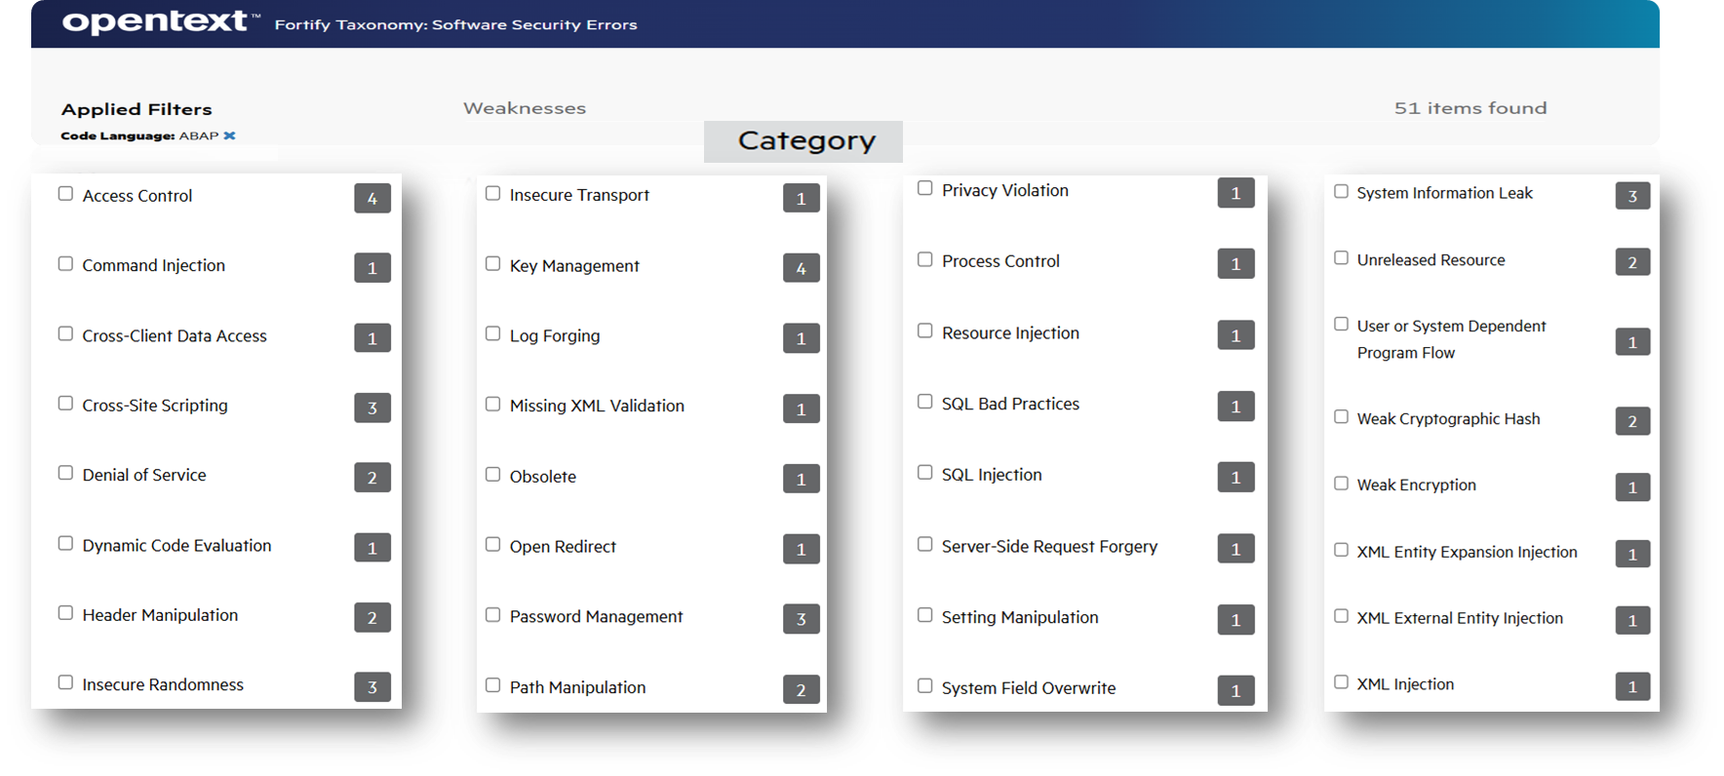
Fortify Scan ABAP – Coverage
Fortify has a comprehensive set of rules for finding vulnerabilities in SAP ABAP Code (see https://vulncat.fortify.com/en/weakness?codelang=ABAP for some examples).
Notes:
https://www.microfocus.com/en-us/assets/cyberres/magic-quadrant-for-application-security-testing

Slide 20
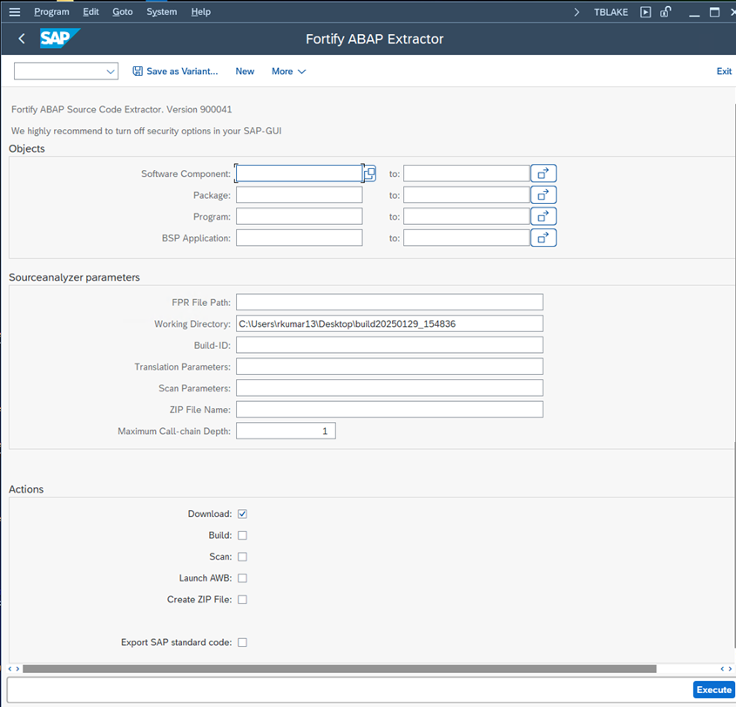
Fortify Scan ABAP –Extractor
The Fortify ABAP Extractor automates the process of extracting SAP ABAP Program code and scanning for vulnerabilities.
ABAP Extractor – Various Options
https://www.microfocus.com/documentation/fortify-static-code-analyzer-and-tools/2440/SCA_Help_24.4.0/index.htm#abap/RunABAPExtractor.htm?Highlight=ABAP
Notes:
https://www.microfocus.com/en-us/assets/cyberres/magic-quadrant-for-application-security-testing

Slide 21
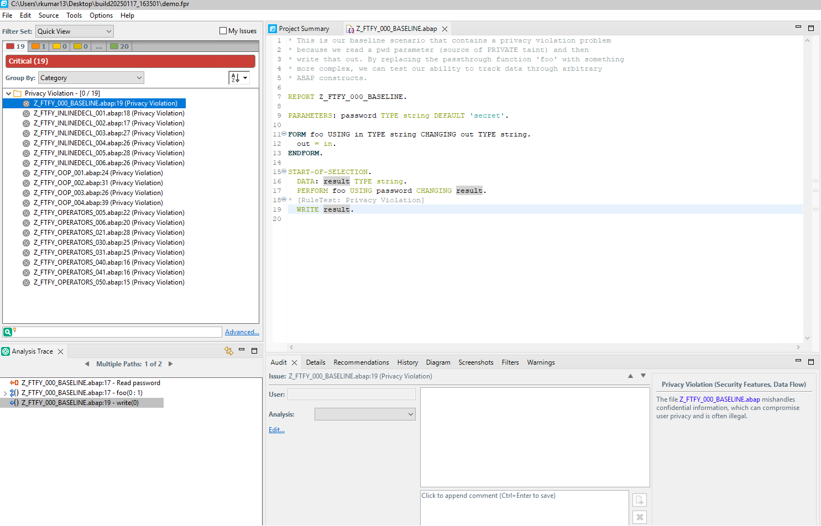
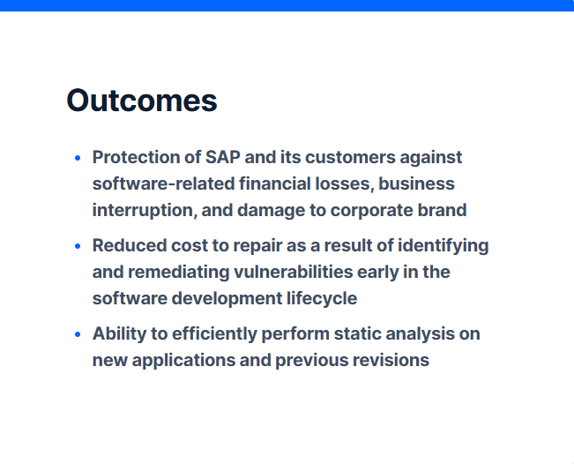
Fortify Scan ABAP – Scan Results
Notes:
https://www.microfocus.com/en-us/assets/cyberres/magic-quadrant-for-application-security-testing

Slide 22

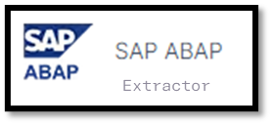
Fortify ABAP – Integration
OpenText Fortify Static Code Analyzer
OpenText Core Software Composition Analysis
OpenText Fortify On Demand
Notes:
https://www.microfocus.com/en-us/assets/cyberres/magic-quadrant-for-application-security-testing

Slide 23
ABAPGit Integration with Fortify Security Workflow
Use ABAPGit to export ABAP code from SAP system into Git repository
Enable version control and CI/CD pipelines for ABAP development
Extract ABAP source code using Fortify ABAP Extractor (via YSCA transaction)
Run Fortify Static Code Analyzer on extracted ABAP files
Review vulnerabilities in Fortify Software Security Center (SSC)
Combine with abaplint for lightweight static checks in GitHub/GitLab CI

